Slide 1

Around the World in Grapey Days
October 5, 2017
Bryan, Paige, Fleder, Meyappan, Aishwarya

Slide 2
Data Description
Wine 101
KEY STATISTICS
151k
Wine Reviews
15k
Wineries
632
Wine Varieties
10
Attributes
Where?
The data was gathered from WineEnthusiast, one of the premier wine and spirits review and trade magazines
What?
The dataset contains descriptions, prices, and points given to each type of wine, varying by variety, region, and winery

Slide 3
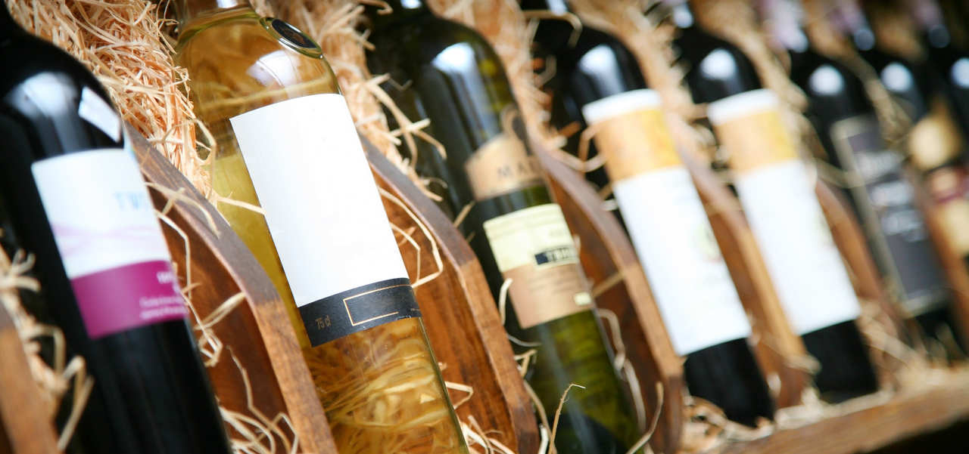
Exploratory Data Analysis

Slide 4
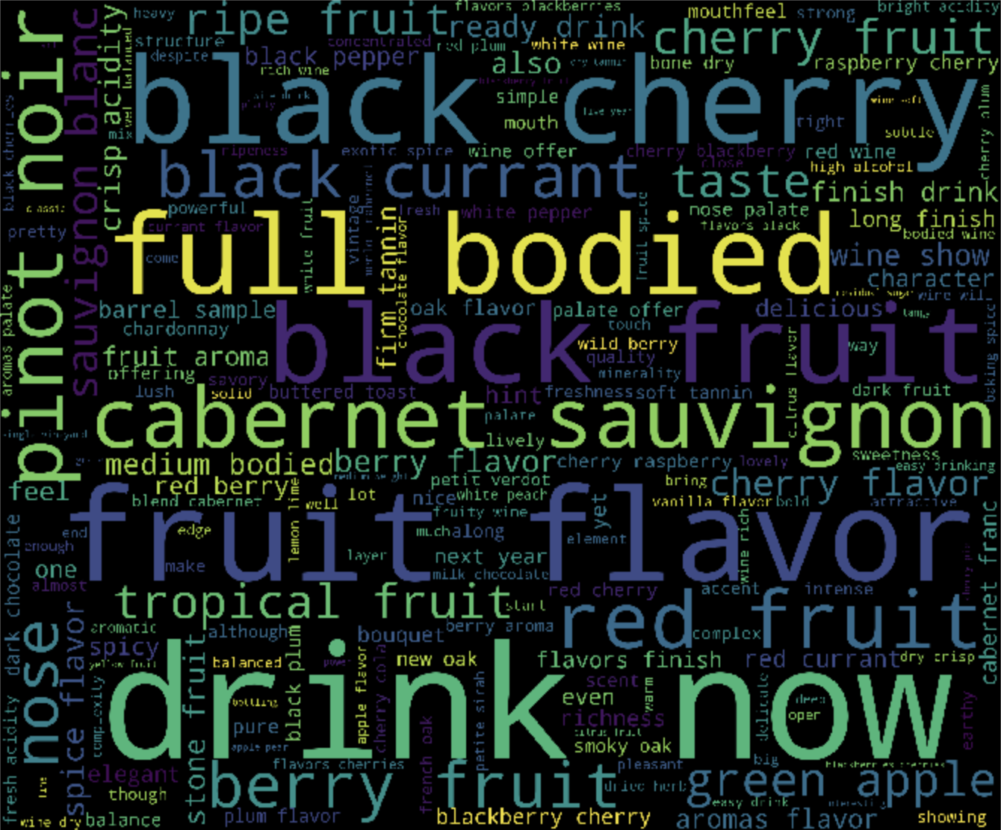
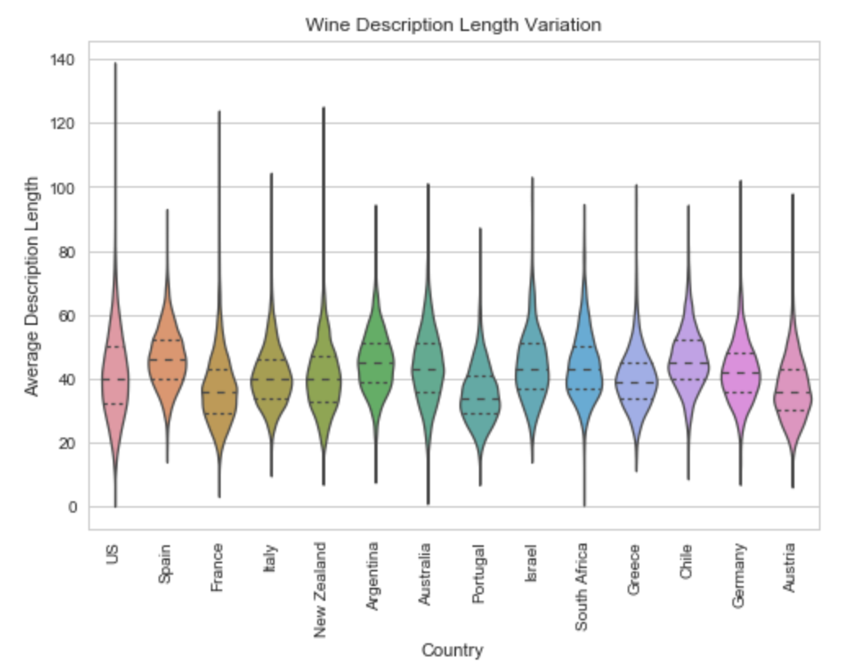
How are wines described?
What attributes are used the most?
Did description length vary by country?

Slide 5
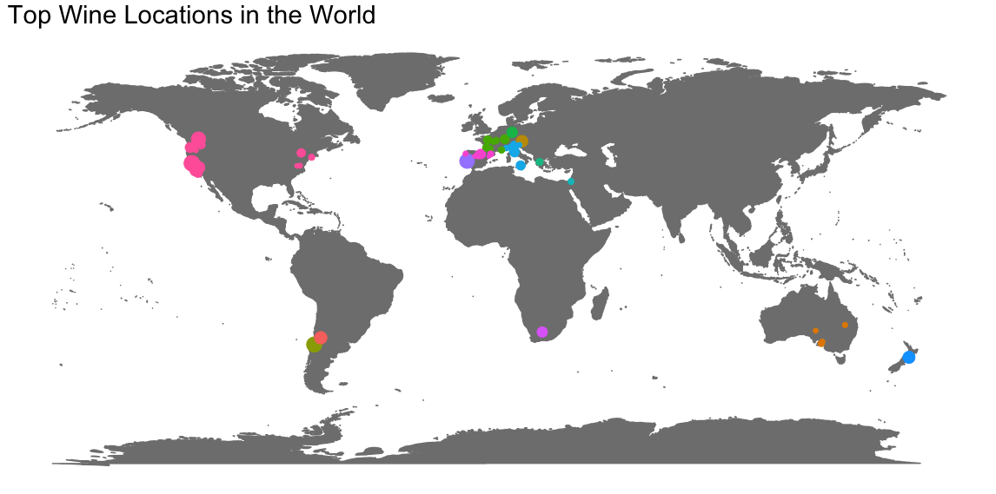
What are the top wine locations in the world?
NOTE: What do these different colors mean?

Slide 6
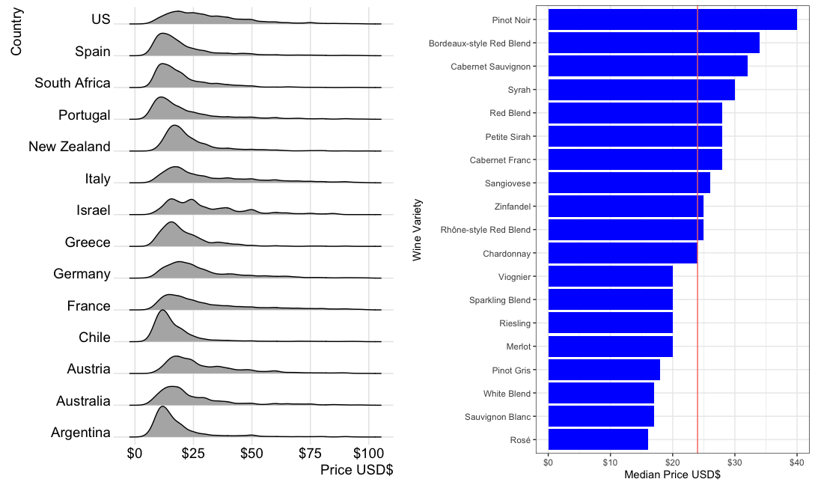
What is the current pricing structure of wines?
By country
By variety

Slide 7
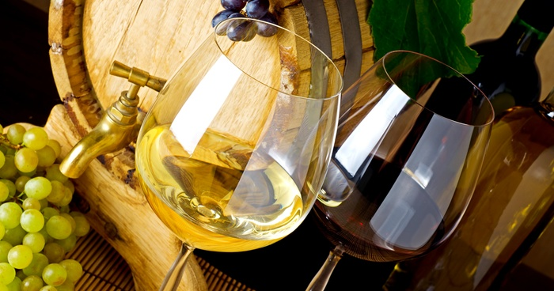
Leveraging Descriptions for Business Insights

Slide 8
Key Business Questions
Evaluate the pricing structure of wines and recommend the reorganization of liquor stores based on similarities between wine varieties
How can expert reviews be used to improve recommendations for liquor stores?
Are stores overpricing or underpricing their wine?
Are stores aware of the attributes used to describe their wine? Are they advertising those attributes clearly?
Can we make wine suggestions to restaurants based on purchase history and menu?

Slide 9




Approach
A four-step approach was implemented to achieve business goals
Preprocessing
Remove undesirable characters(@,!, etc)
Remove stop words
Analysis
Calculate lift values of top 25 wine varieties against top 20 attributes
Vectorize each variety and calculate cosine similarities
Insights
Reviews utilize similar descriptions regardless of price, though mentions of food can hint at quality
US wines tend to be pricier on the average
Recommendations
Liquor stores should organize by flavor profiles rather than regions
Notes:
http://passionatefoodie.blogspot.com/2010/07/what-is-best-way-to-organize-wine-store.html

Slide 10
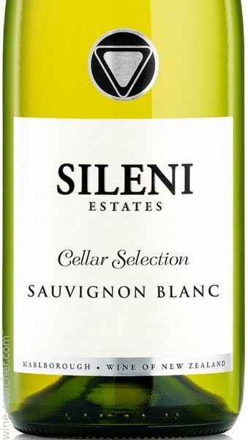
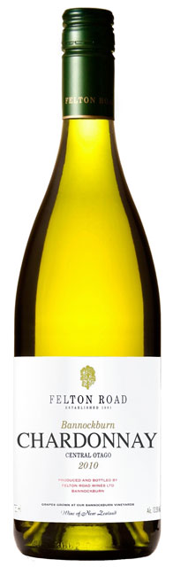
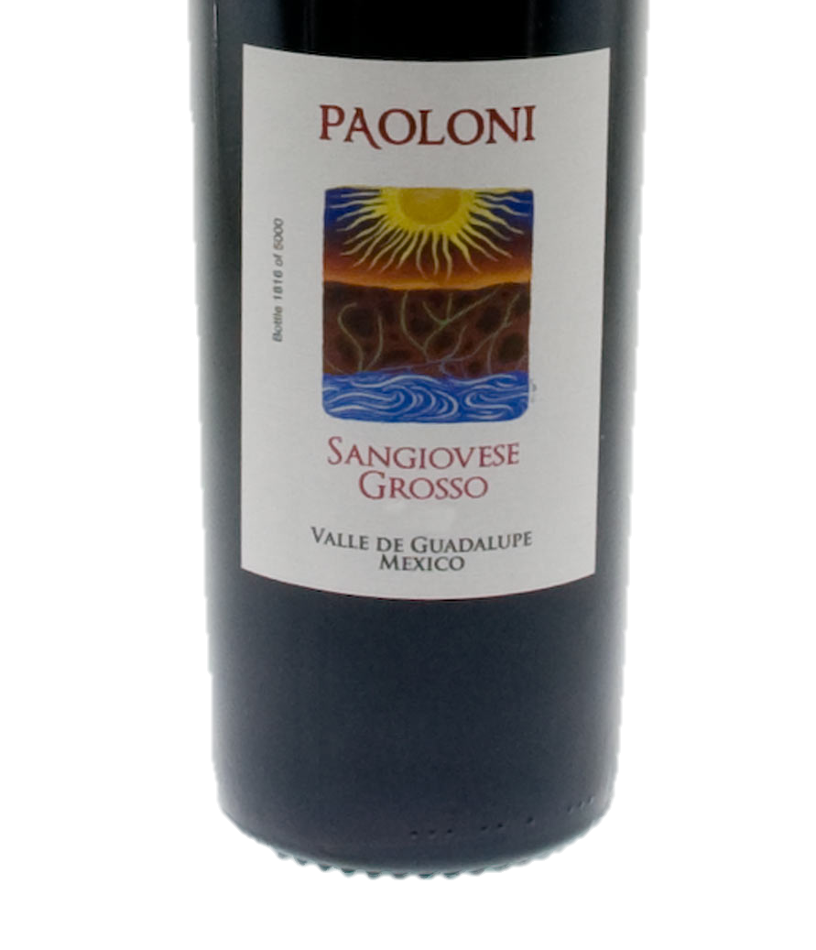
Can cosine similarity predict the next variety you should try?
Cosine similarity: 0.831
Most similar attributes:
Acidity, Fruit, Citrus, Crisp
Cosine similarity .442
Least similar attributes:
Cherry, Apple, Berry, Spice

Slide 11
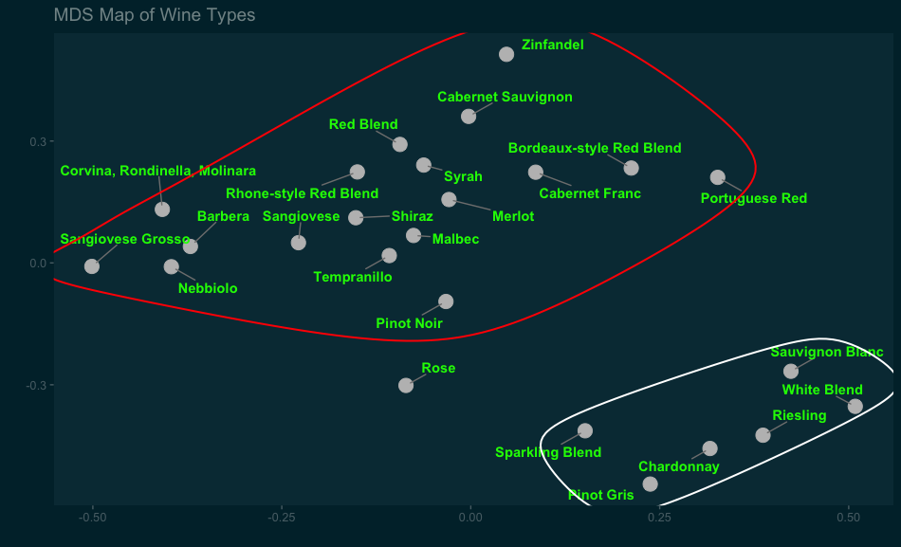
Can cosine similarity predict the next variety you should try?

Slide 12
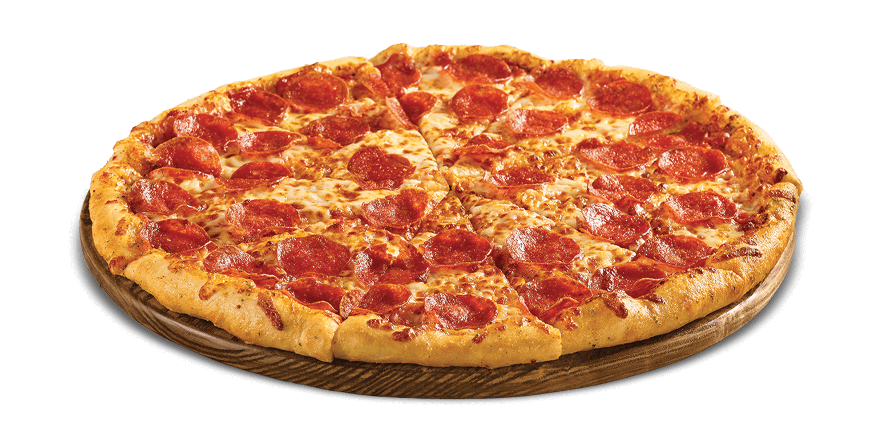
What is average rating when each of these foods are mentioned in the review?
Cheap Chow
Fancy Food
The avg. rating is 0.74 SD above the mean
The avg. rating is 0.98 SD below the mean
The avg. rating is 0.72 SD below the mean
The avg. rating is 0.52 SD above the mean
The avg. rating is 0.64 SD below the mean
The avg. rating is 0.36 SD above the mean
The avg. rating is 0.53 SD below the mean

